Slide 1
My Portfolio Website
By Nick Ruslan

Slide 2
Contents:
Sitemap
Wireframe
Components

Slide 3
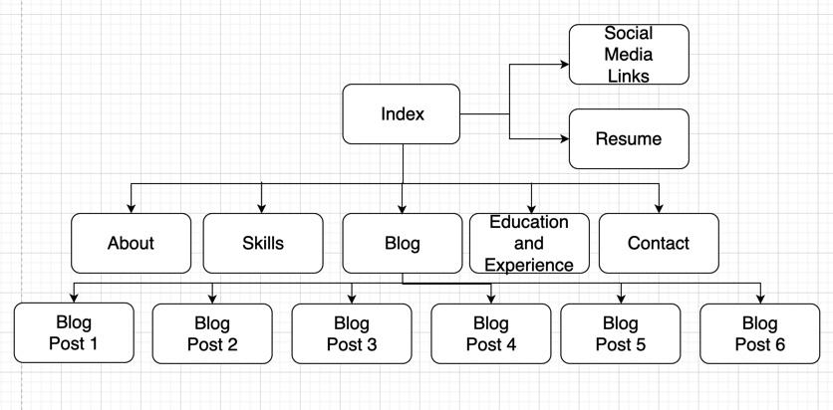
Sitemap:

Slide 4
Wireframe:
https://www.figma.com/file/3BBR9WDu4jY8YYQSIso2ud/Portfolio-Draft?node-id=0-1&t=Upt96sJDrcWR8Ip6-0

Slide 5
Components:
Clean and simple style
Colours that pop off against the white background
Download link to allow clients to access my resume easily
Split page design for ease of reading
Stylish name used as logo
Multiple breakpoints for different devices(PC, tablet, mobile phone)
Blog items listed with pictures
Each blog item in list has own url to blog post

Slide 6
End of slide deck. Thank you for watching!

